Slide 1
Introduction and Logistics
Rob Minneker

Slide 2
Fire Safety and Evacuation Plan
https://healthsafety.cs.washington.edu/wp-content/uploads/2025/06/Gates-Center-FSEP-2025.06.05.pdf
  Please review and be aware of your exits
  No elevators
  Meet at assembly point (Rainier Vista is safe bet)

Slide 3
Course Overview and Structure

Slide 4
What is NLP? NLU? LM? LLM? LMM? what???
NLP: Natural language processing
NLU: Natural language understanding
LM: Language model
LLM: Large language model
LMM: Large multimodal model
NLP is a broad term that encompasses all things computers + human language (both understanding and generating): e.g. speech recognition, language translation, sentiment analysis, summarization, etc.

Slide 5
Course Objectives (1/4)
Natural Language Processing (NLP) investigates computational approaches to analyzing, generating, and understanding human language.
Objective: Develop a rigorous understanding of core NLP concepts and algorithms
  Formal models: probabilistic, neural, and symbolic paradigms
  Foundational tasks: parsing, tagging, language modeling

Slide 6
Course Objectives (2/4)
Emphasis on practical, hands-on experience with real-world NLP applications
  Implementation of core methods (e.g., text classification, natural language generation)
  Use of standard datasets and evaluation metrics/approaches

Slide 7
Course Objectives (3/4)
Critical engagement with current NLP research literature
  Analyzing recent advances and their limitations
  Understanding open problems and future research directions
Applications:
Machine translation, question answering, information extraction
Language generation, summarization, sentiment analysis

Slide 8
Course Objectives (4/4)
Learning outcomes:
  Formulate and analyze NLP models mathematically
  Design, implement, and critically evaluate NLP systems
  Synthesize and critique cutting-edge NLP research
  Leverage these tools/systems to do good things

Slide 9
Course Structure and Logistics (1/4)
The course is organized around lectures, assignments, a final project and interactive participation, with no final exam or in-class quizzes and no quiz section
Emphasis is placed on continual engagement and critical thinking rather than high-stakes testing
  This structure encourages regular review and deeper understanding of NLP topics

Slide 10
Course Structure and Logistics (2/4)
Assignments are the primary means of assessment
  Each student has 5 penalty free late days
    You may use a maximum of 3 days (72 hours) on any one assignment
  Anything when late days are exhausted will receive no credit

Slide 11
Course Structure and Logistics (3/4)
Grading breakdown:
  Major components: assignments, final project, and participation
  Contributions:
    Assignments (50%)
      A1 (15%), A2 (15%), A3 (20%)
    Project (50%)
      Various checkpoints (mini assignments) throughout the quarter
    Participation (up to 4%)
      Course surveys, completion-based activities

Slide 12
Course Structure and Logistics (4/4)
Assignments
  3 longer assignments with coding/analysis, notebook based
    Largely auto graded (hidden tests)
    517 has extra problem or so, 447 can do for some extra points
    2 weeks from release to submission
Project
  More details on Thursday
    tldr; Group project, 517 has more ambiguity

Slide 13
Teaching Staff
Instructor: Rob
TAs:
  Victoria (Lead)
  Anagha
  Ben
  Boe
  Jize
  Khushi
  Min
  Praveer

Slide 14
Natural Language Processing: Scope and Significance

Slide 15
Definition and Scope of NLP (1/4)
Natural Language Processing (NLP) is the computational study of human language, aiming to enable machines to interpret, generate, and interact using natural language.

Slide 16
Definition and Scope of NLP (2/4)
NLP spans multiple levels of linguistic analysis:
  Phonology: study of speech sounds and their patterns
  Morphology: structure of words and morphemes
  Syntax: grammatical structure of sentences
  Semantics: meaning of words, phrases, and sentences
  Pragmatics: context-dependent aspects of meaning and use

Slide 17
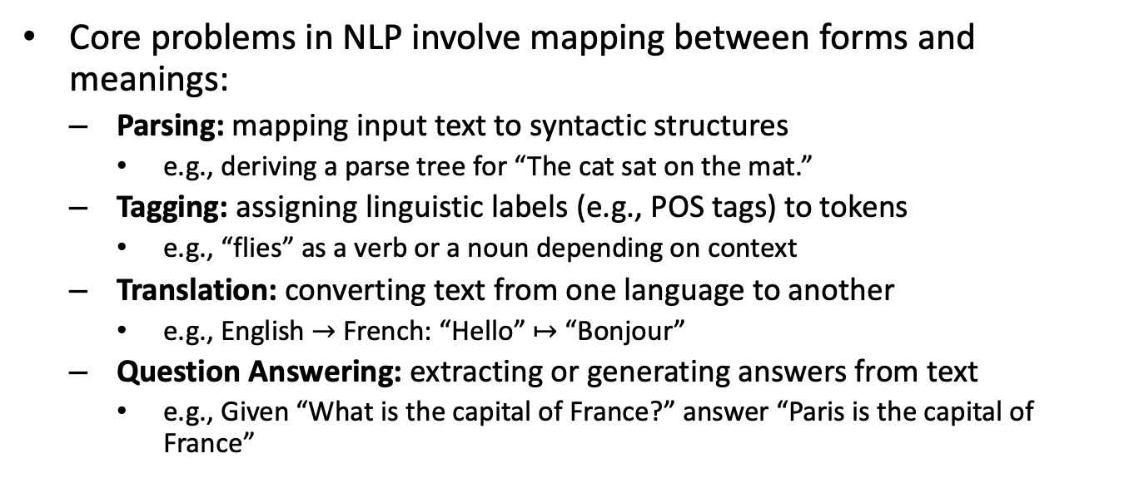
Definition and Scope of NLP (3/4)
Core problems in NLP involve mapping between forms and meanings:
  Parsing: mapping input text to syntactic structures
    e.g., deriving a parse tree for “The cat sat on the mat.”
  Tagging: assigning linguistic labels (e.g., POS tags) to tokens
    e.g., “flies” as a verb or a noun depending on context
  Translation: converting text from one language to another
    e.g., English $→$ French: “Hello” $↦$ “Bonjour”
  Question Answering: extracting or generating answers from text
    e.g., Given “What is the capital of France?” answer “Paris is the capital of France”

Slide 18
Definition and Scope of NLP (4/4)
Now is the time of LLMs (or GenAI more broadly)
  ChatGPT
  DeepSeek
  Claude
  GitHub Copilot
  Llama Etc.
  Not just text-to-text, also text-to-image, text-to-video, … (multimodality)

Slide 19
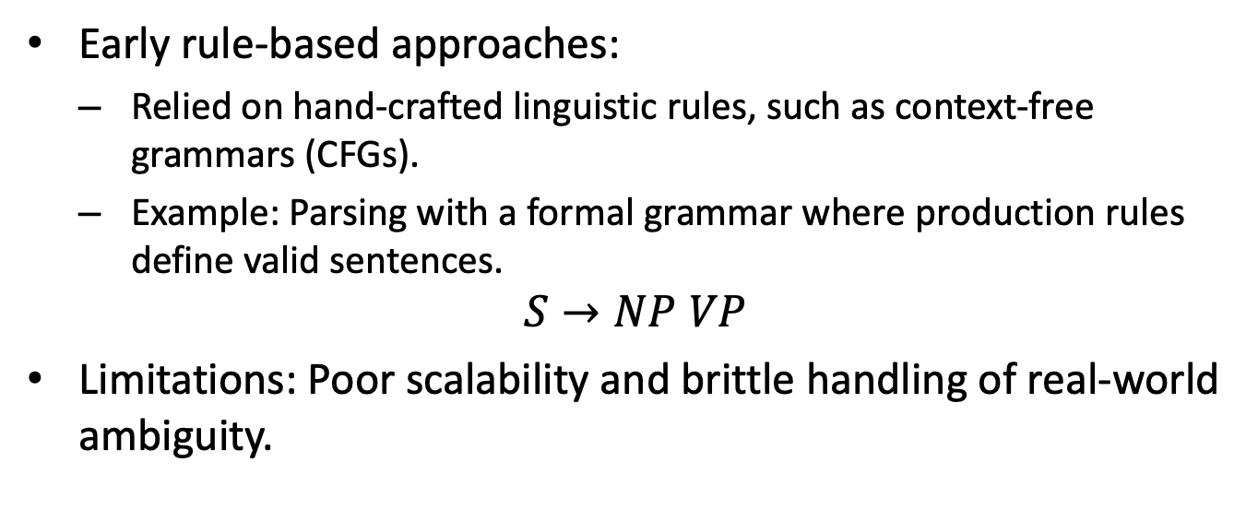
Historical Perspective (1/3)
Early rule-based approaches:
  Relied on hand-crafted linguistic rules, such as context-free grammars (CFGs).
  Example: Parsing with a formal grammar where production rules define valid sentences.
$$S→NP VP$$
Limitations: Poor scalability and brittle handling of real-world ambiguity.

Slide 20
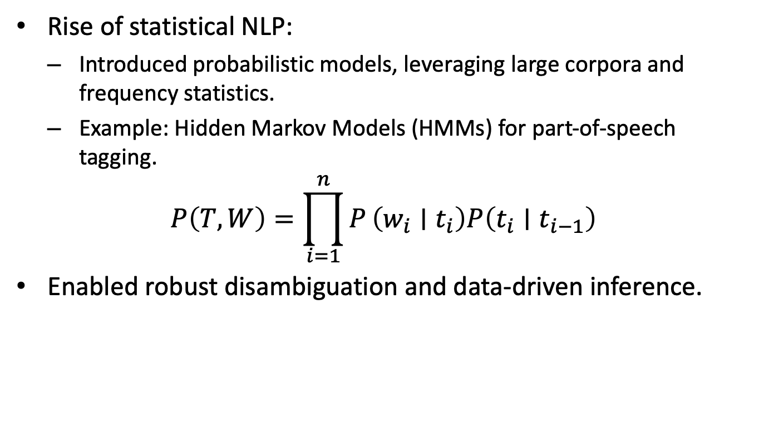
Historical Perspective (2/3)
Rise of statistical NLP:
  Introduced probabilistic models, leveraging large corpora and frequency statistics.
  Example: Hidden Markov Models (HMMs) for part-of-speech tagging.
$$P\left(T,W\right)=\prod_{i=1}^{n}{P}\left(w_{i}∣t_{i}\right)P\left(t_{i}∣t_{i−1}\right)$$
Enabled robust disambiguation and data-driven inference.

Slide 21
Historical Perspective (3/3)
Advent of neural and deep learning methods:
  Shifted focus to distributed representations and end-to-end learning.
  Example: Word embeddings (e.g., word2vec) model words as dense vectors, capturing semantic similarity.
  Deep architectures (e.g., transformers) achieve state-of-the-art results in diverse NLP tasks.
Applications:
- Machine translation, question answering, sentiment analysis

Slide 22
NLP in AI and Society (1/3)
Natural Language Processing (NLP) enables computational systems to analyze, understand, and generate human language, serving as a core component in modern artificial intelligence.
NLP bridges human communication and machine intelligence
  Facilitates information exchange between users and AI-driven systems
  Essential for tasks requiring understanding of unstructured, ambiguous text

Slide 23
NLP in AI and Society (2/3)
Key applications in contemporary technology:
  Search engines: interpret queries, rank and retrieve relevant documents
  Virtual assistants: parse spoken/written language, execute user commands
  Information extraction: identify entities, relations, and facts from text corpora
  Summarization: condense large documents while preserving salient information

Slide 24
NLP in AI and Society (3/3)
Societal Impact and Ethical Considerations:
Widespread deployment of NLP systems raises critical issues:
  Algorithmic bias: NLP models may amplify social biases present in training data
  Privacy: processing sensitive language data can compromise user confidentiality
  Misinformation: automated generation and summarization may propagate errors or distortions

Slide 25
Fundamental Concepts and Theory

Slide 26
Probability and Statistics in NLP (1/4)
Probability and statistics provide the mathematical foundation for modeling uncertainty and learning from data in NLP.
Discrete probability spaces underpin language modeling
  The probability of a sequence $w_{1},w_{2},…,w_{n}$ is given by
$$P\left(w_{1},w_{2},…,w_{n}\right)=\prod_{i=1}^{n}{P}\left(w_{i}∣w_{1},…,w_{i−1}\right)$$

Slide 27
Probability and Statistics in NLP (2/4)
Markov assumptions (e.g., n-gram models) simplify modeling by limiting context
Maximum Likelihood Estimation (MLE) is used to fit statistical language models
  For unigram models:
$$\hat{P}\left(w\right)=\frac{\text{count}\left(w\right)}{\sum_{w′}^{​}{\text{count}}\left(w′\right)}$$
MLE provides unbiased estimators under i.i.d. assumptions

Slide 28
Probability and Statistics in NLP (3/4)
Evaluation metrics for NLP tasks are grounded in statistical decision theory
  Accuracy: proportion of correct predictions over all cases
  Precision, recall, and F1 for imbalanced or structured outputs:
$$\text{Precision}=\frac{TP}{TP+FP}, \text{Recall}=\frac{TP}{TP+FN}$$

Slide 29
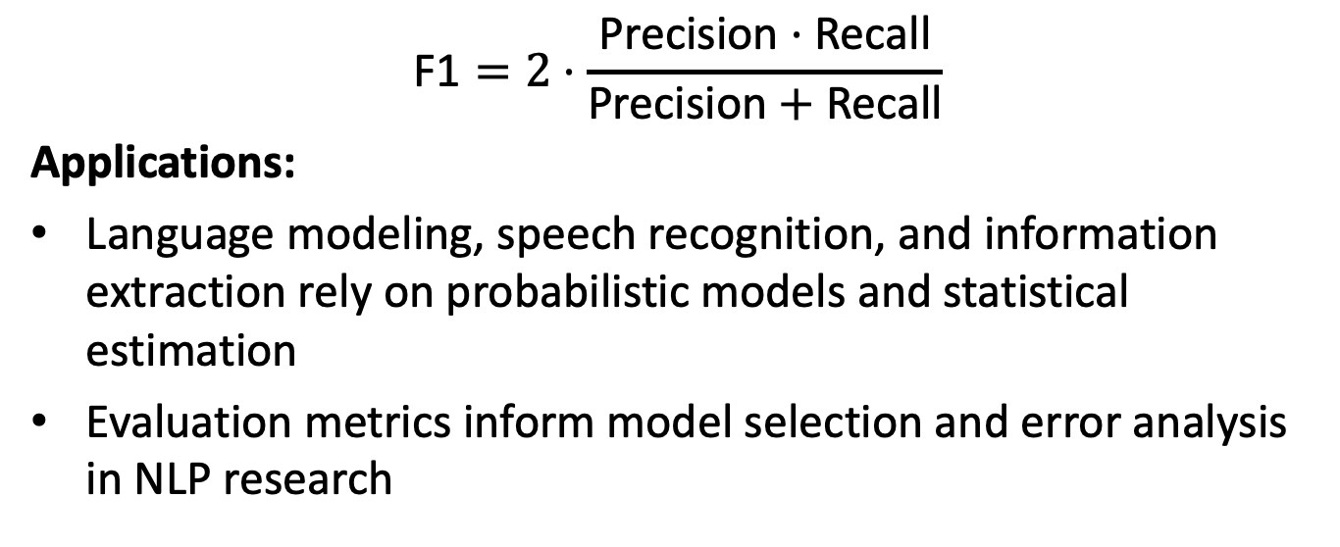
Probability and Statistics in NLP (4/4)
$$\text{F}\text{1}=2⋅\frac{\text{Precision}⋅\text{Recall}}{\text{Precision}+\text{Recall}}$$
Applications:
Language modeling, speech recognition, and information extraction rely on probabilistic models and statistical estimation
Evaluation metrics inform model selection and error analysis in NLP research

Slide 30
Machine Learning Paradigms in NLP (1/4)
Machine Learning paradigms provide foundational frameworks for modeling linguistic phenomena in NLP, shaping how language data is represented, learned from, and generalized.

Slide 31
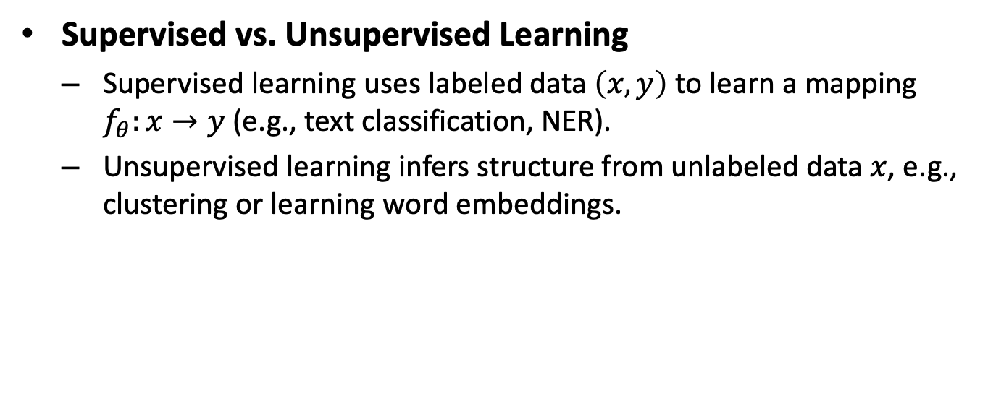
Machine Learning Paradigms in NLP (2/4)
Supervised vs. Unsupervised Learning
  Supervised learning uses labeled data $\left(x,y\right)$ to learn a mapping $f_{θ}:x→y$ (e.g., text classification, NER).
  Unsupervised learning infers structure from unlabeled data $x$, e.g., clustering or learning word embeddings.

Slide 32
Machine Learning Paradigms in NLP (3/4)
Feature Representation for Language
  Early NLP relied on hand-crafted features: $n$-grams, POS tags, parse trees.
  Modern approaches use distributed representations: word embeddings (e.g., Word2Vec, GloVe), contextual vectors from transformers.
  Formally, embeddings map discrete tokens to $ℝ^{d}$:
$$Embed:w↦v_{w}∈ℝ^{d}$$

Slide 33
Machine Learning Paradigms in NLP (4/4)
Transfer Learning and Pre-trained Models
  Large models are pre-trained on massive corpora via self-supervised objectives (e.g., masked language modeling).
  Pre-trained representations are fine-tuned for downstream tasks, dramatically reducing labeled data requirements.
  Example: BERT, GPT, and their variants set new state-of-the-art on many NLP benchmarks.

Slide 34
Course Logistics and Resources

Slide 35
Course Website and Communication (1/3)
Course Website and Communication
The course website serves as the authoritative source for schedules, policies, and resource links.
  All lecture materials, assignment deadlines, and readings are posted here.
  Updates to the syllabus or schedule are reflected promptly.
  https://courses.cs.washington.edu/courses/cse447/26wi
  cs.uw.edu/447 also works for any current course

Slide 36
Course Website and Communication (2/3)
Use Ed!
  Students are encouraged to post questions, share insights, and discuss assignments.
  Please tag your posts appropriately to help others find them and dedup efforts

Slide 37
Course Website and Communication (3/3)
Official announcements are communicated via Ed
  Students must monitor institutional email accounts regularly.
  Time-sensitive updates (e.g., schedule changes) are distributed through multiple channels.

Slide 38
Assignment and Project Logistics (1/2)
Homework guidelines:
  Regular submission deadlines; late policy strictly enforced
  Submissions via Gradescope
  Each assignment targets core concepts
    Text Classification and N-gram language models
    Neural Text Classification and Neural Language Modeling
    Transformers and Natural Language Generation

Slide 39
Assignment and Project Logistics (2/2)
Academic integrity and collaboration:
  Discussion of concepts encouraged; all code and writeups must be individual
  Plagiarism, including copying from peers or online sources, is a violation
  Proper attribution required for external resources or libraries
  GenAI use is permitted and encouraged (must cite this)
    Particularly for studying or targeted coding help; less useful for conceptual questions on assignments

Slide 40
Next time
Project overview/requirements
Words and Tokens (~J&M Ch. 2)

Slide 41
Sources
Content derived from: course website, prior quarters

